Slide 1

Digital Logic Design

Slide 2
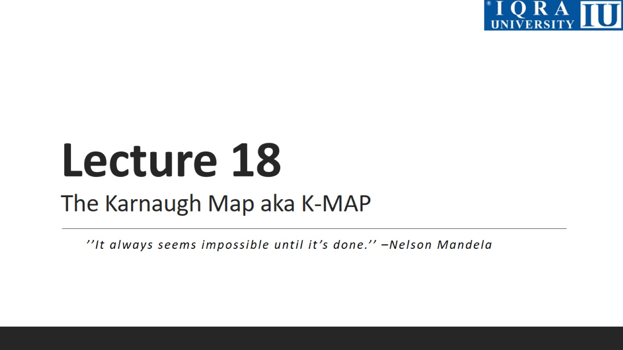
Lecture 18 The Karnaugh Map aka K-MAP

Slide 3
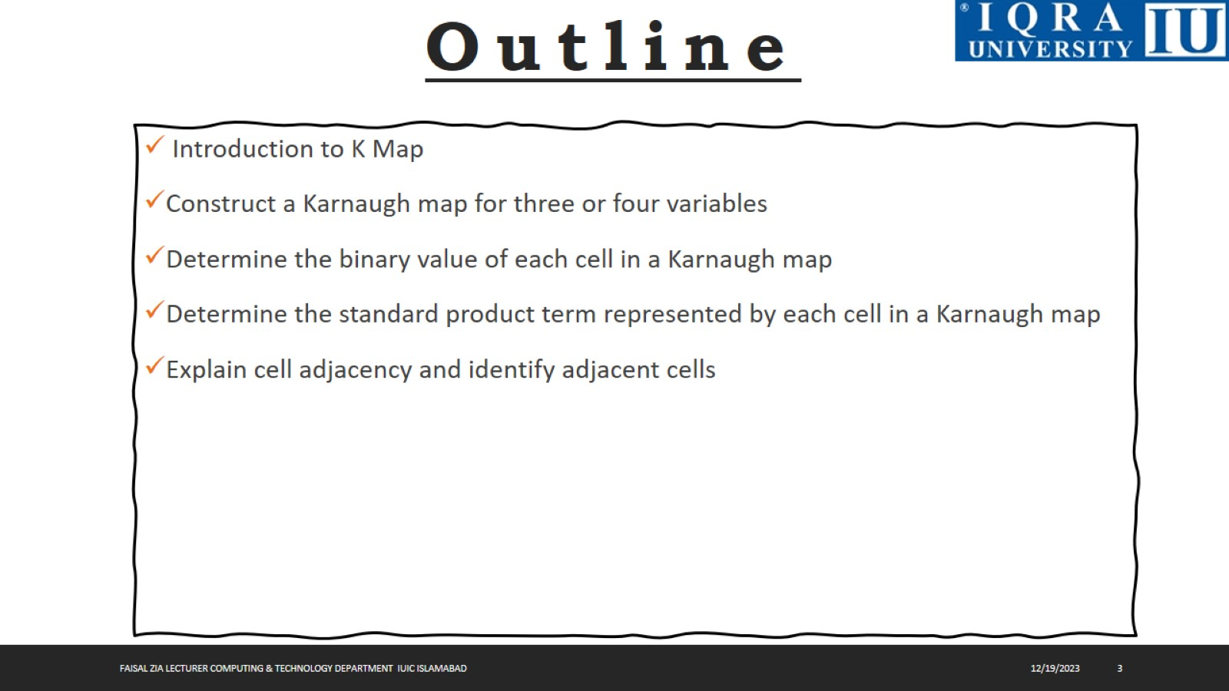

Slide 4
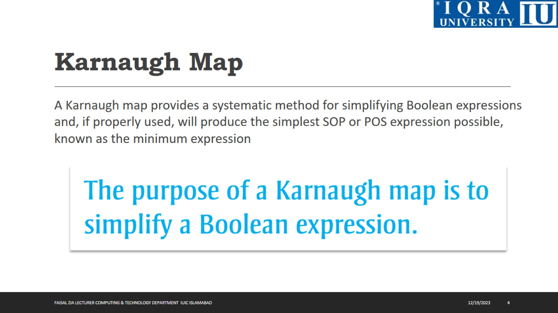
Karnaugh Map

Slide 5
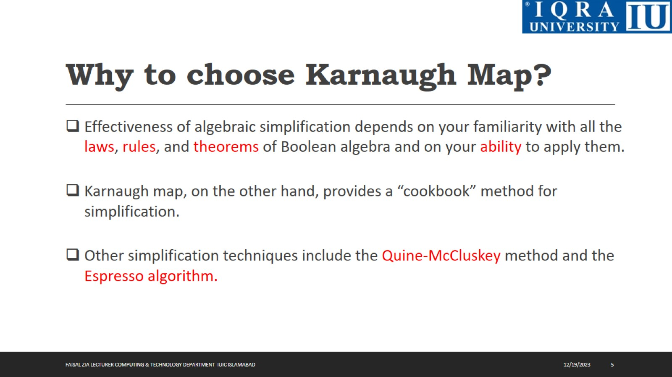
Why to choose Karnaugh Map?

Slide 6
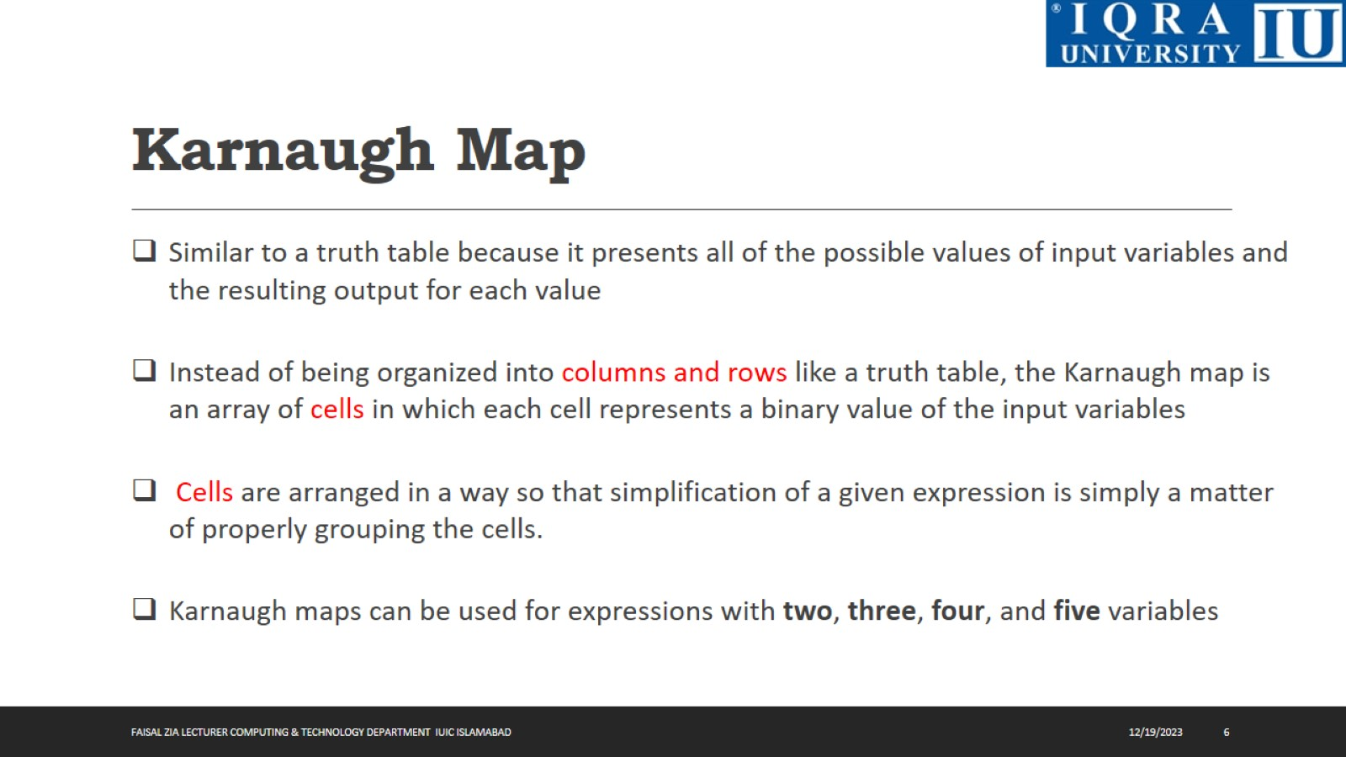
Karnaugh Map

Slide 7
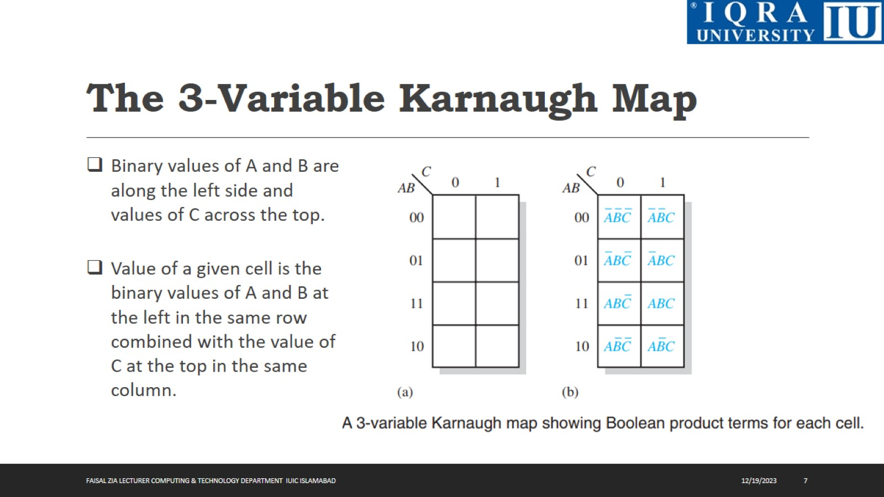
The 3-Variable Karnaugh Map

Slide 8
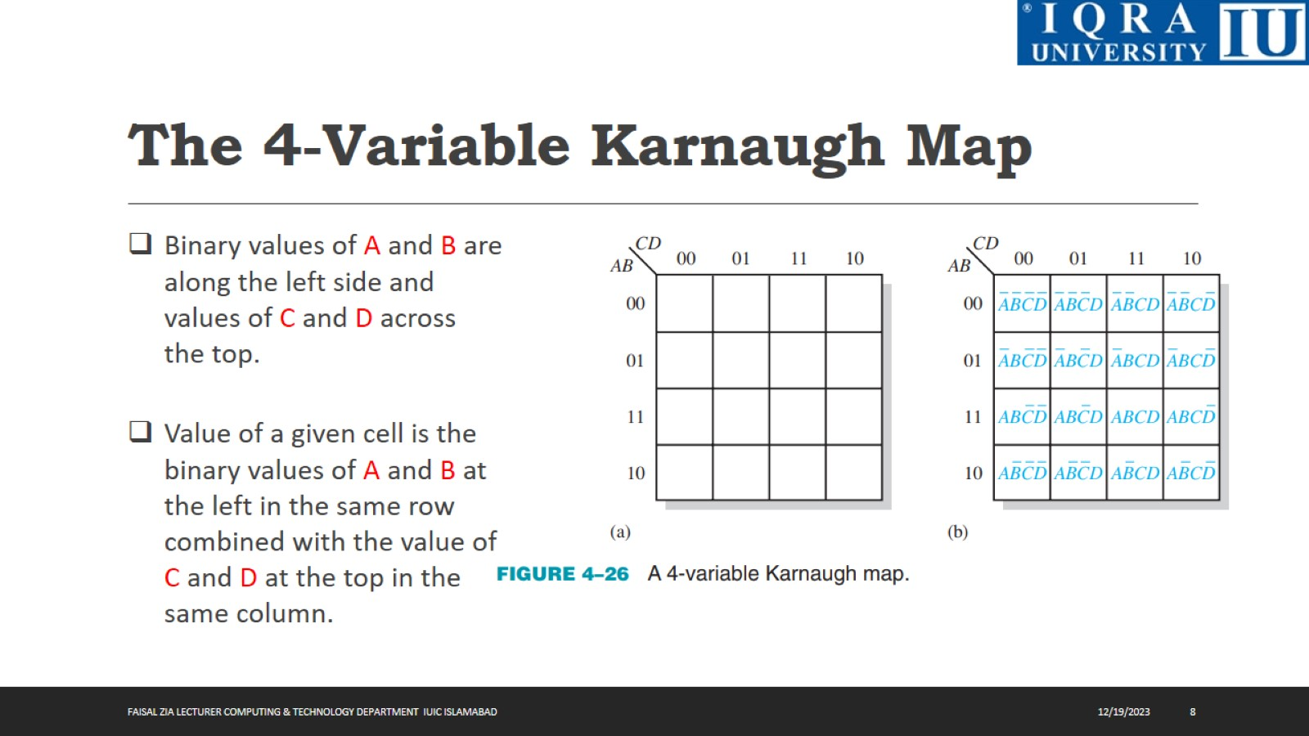
The 4-Variable Karnaugh Map

Slide 9
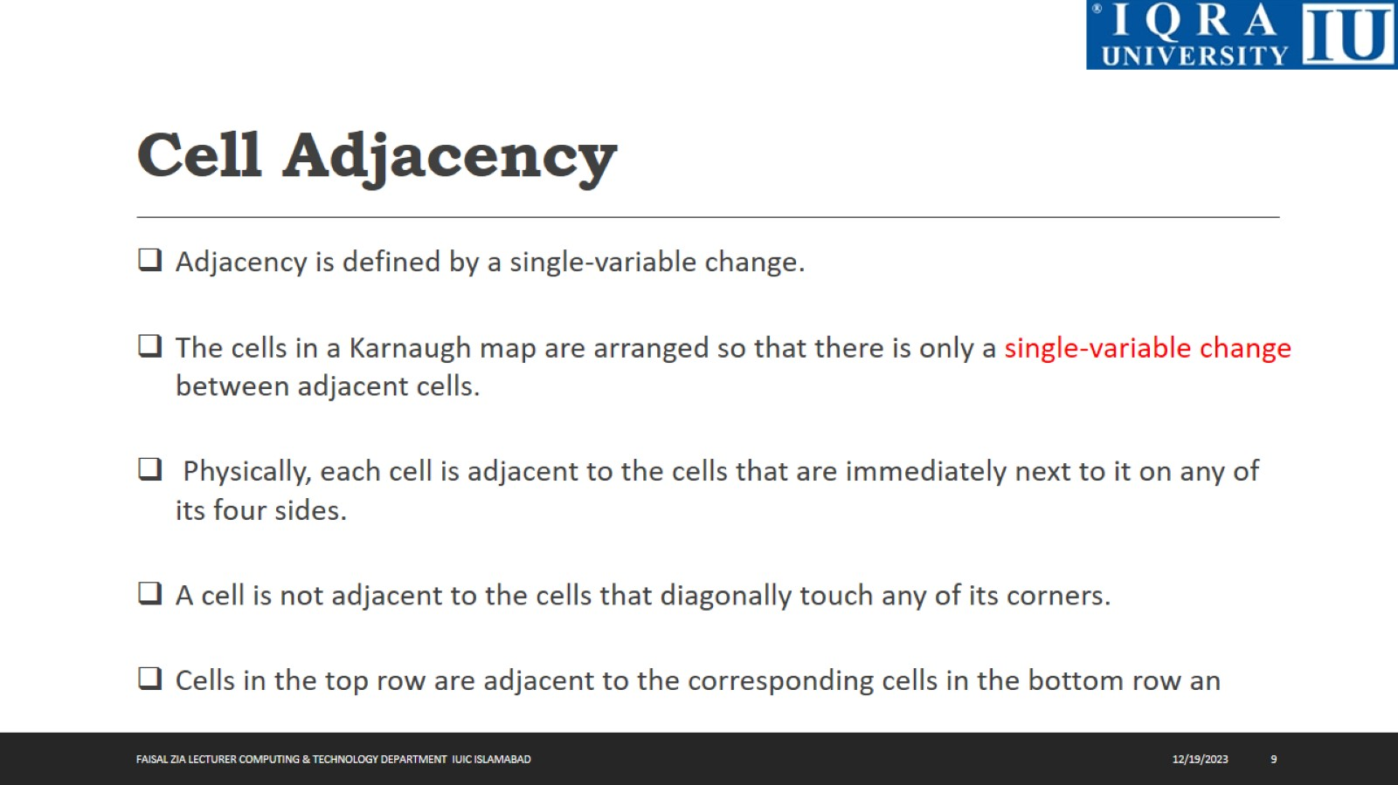
Cell Adjacency

Slide 10
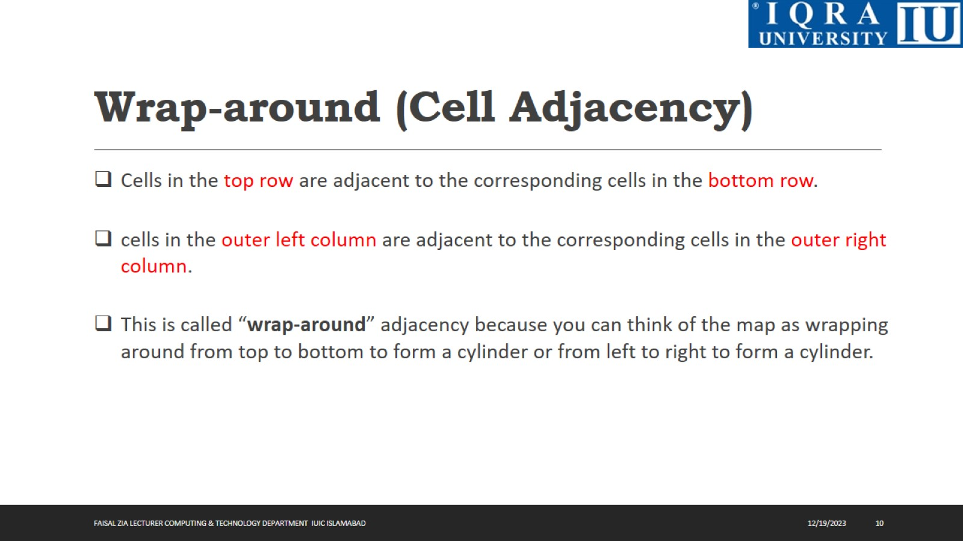
Wrap-around (Cell Adjacency)

Slide 11
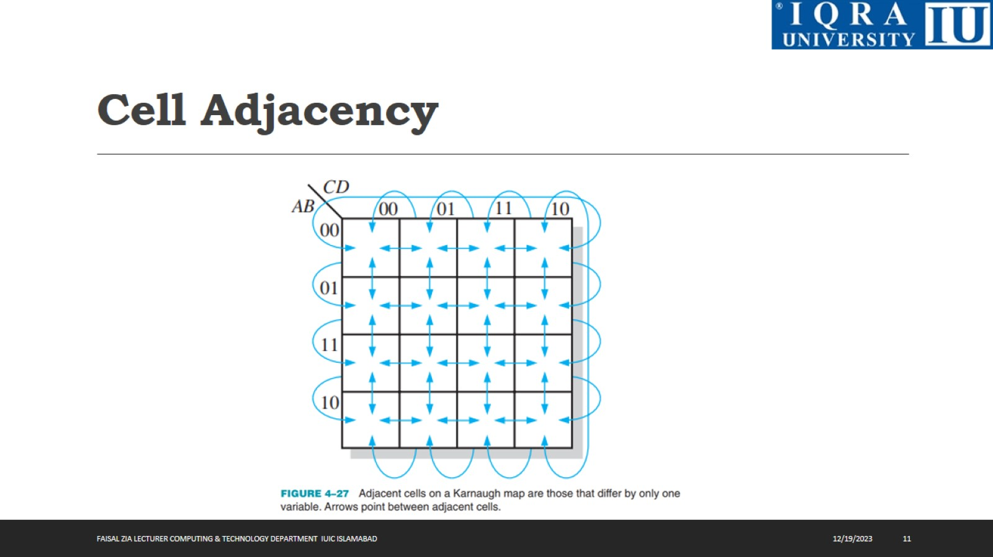
Cell Adjacency

Slide 12
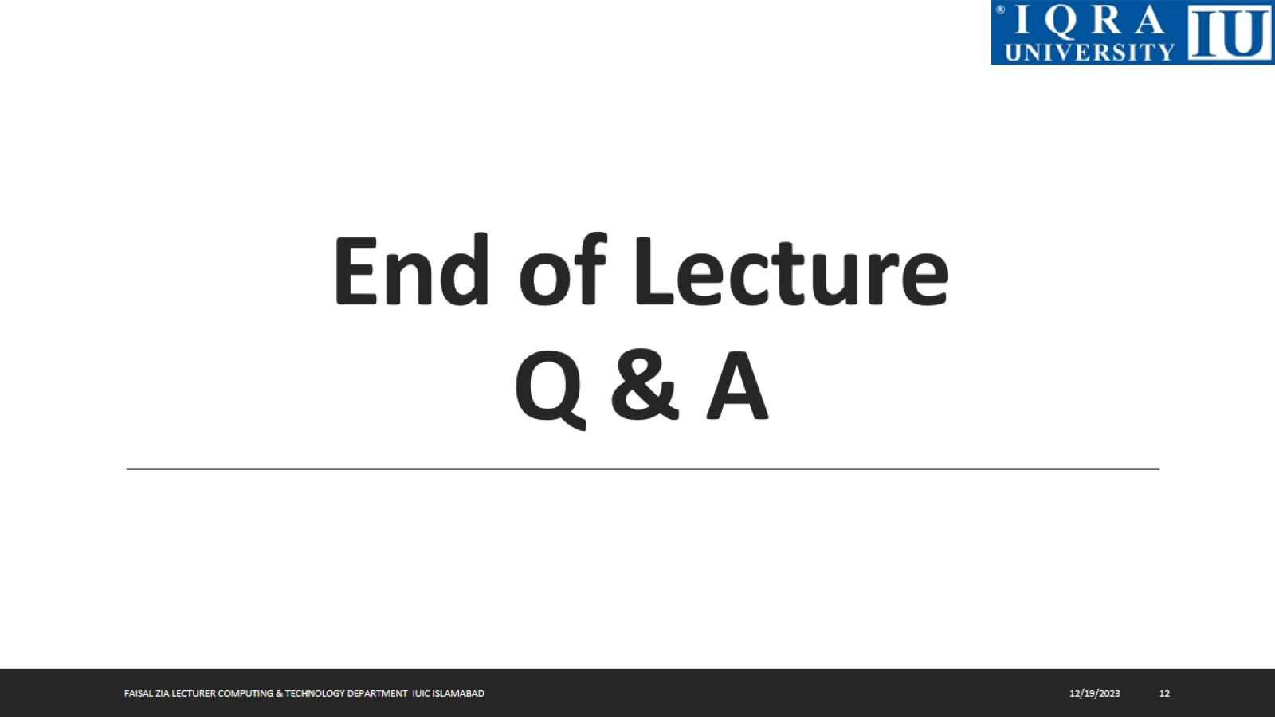
End of Lecture Q & A

